Slide 1
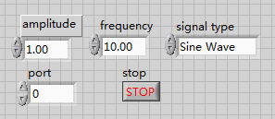
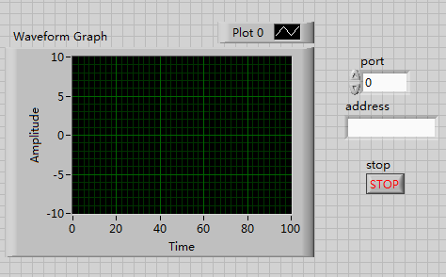
LabVIEW GUI Design
By Hui Li
The interface send a signal and receive and display the signal using TCP socket for connection.
Send interface
Receive interface

Slide 2
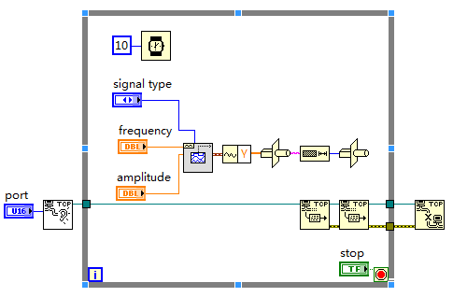
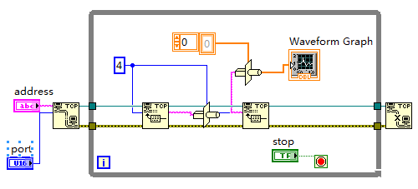
Send block diagram
Receive block diagram

Slide 3
Future Plan
Get the port and address to test the function of block diagram.
Use different data types to see which data type signal is better displayed in LabVIEW.
Display three signals with their names and sites at the same time .

